Slide 1

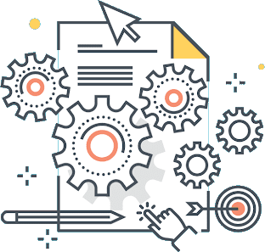

Software Architecture
Micromaster

Slide 2
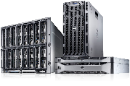

Cloud Models, a little concept
On Premise: On-premises cloud infrastructure is a term related to cloud computing, which seems to contradict a central principle of cloud services, namely, that cloud services are typically provided off-site as a fundamental part of cloud technology design. On-premises cloud infrastructure would be hardware that is related to cloud services or activities, that is nonetheless located on-site at the client’s physical business location.
Infrastructure As A Service (IaaS) means delivering computing infrastructure as on-demand services. It is one of the three fundamental cloud service model servers storage network operating system. In the user purchasing servers, software data center space, or network equipment and rent those resources as a fully outsourced service can demand model. It allows dynamic scaling and the resources are distributed as a service. It generally includes multiple-user on a single piece of hardware.
IaaS
Platform As A Service (PaaS) is a cloud delivery model for applications composed of services managed by a third party. It provides elastic scaling of your application which allows developers to build applications and services over the internet and the deployment models include public, private and hybrid.
PaaS
Software As A Service (SaaS) allows users to run existing online applications and it is a model software that is deployed as a hosting service and is accessed over Output Rephrased/Re-written Text the internet or software delivery model during which software and its associated data are hosted centrally and accessed using their client, usually an online browser over the web. SAAS services are used for the development and deployment of modern applications.
SaaS

Slide 3
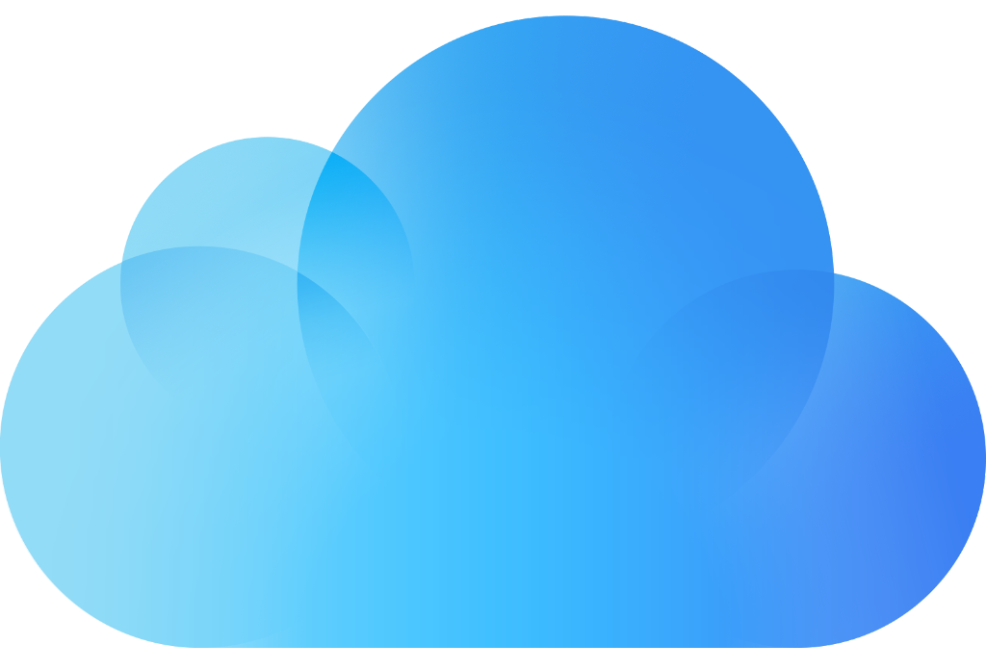
Cloud Models, a little concept
Infrastructure-as-a-Service, Platform-as-a-Service, and Software-as-a-Service may have you scratching your head. But they subtly describe the different tasks and responsibilities service providers offer.
1. IaaS (Infrastructure-as-a-Service) offers environments that are scalable, controllable and automated.
2. PaaS (Platform-as-a-Service) provides a framework that lets you create and release applications quickly. It also automates and manages the provision of infrastructure.
3. SaaS (Software-as-a-Service) allows programs to run remotely and is accessible through the Internet. So you don’t need to run a program from a certain device
Cloud Services
SaaS
PaaS
IaaS
Software as a Service
Platform as a Service
Infraestructure as a Service
Use
Build
Move

Slide 4
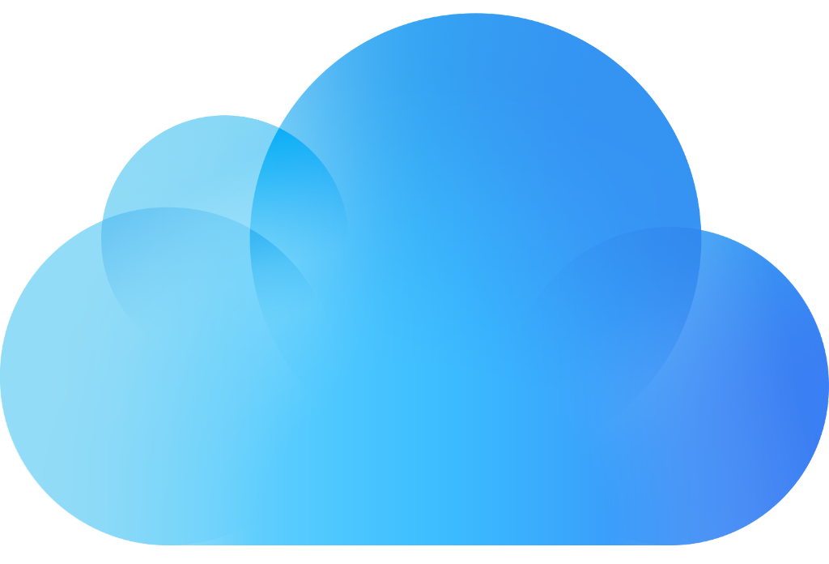
Cloud Models, advantages
Advantages of IaaS
The resources can be deployed by the provider to a customer’s environment at any given time.
Its ability to offer the users to scale the business based on their requirements.
The provider has various options when deploying resources including virtual machines, applications, storage, and networks.
It’s potential to handle an immense number of users.
It is easy to expand and saves a lot of money. Companies can afford the huge costs associated with the implementation of advanced technologies.
IaaS

Slide 5
Cloud Models, advantages
Advantages of PaaS
Programmers need not worry about what specific database or language the application has been programmed in.
It offers developers the to build applications without the overhead of the underlying operating system or infrastructure.
Provides the freedom to developers to focus on the application’s design while the platform takes care of the language and the database.
PaaS

Slide 6
Cloud Models, advantages
Advantages of SaaS
It is a cloud computing service category providing a wide range of hosted capabilities and services. These can be used to build and deploy web-based software applications.
It provides a lower cost of ownership than on-premises software. The reason is it does not require the purchase or installation of hardware or licenses.
It can be easily accessed through a browser along a thing client.
SaaS

Slide 7
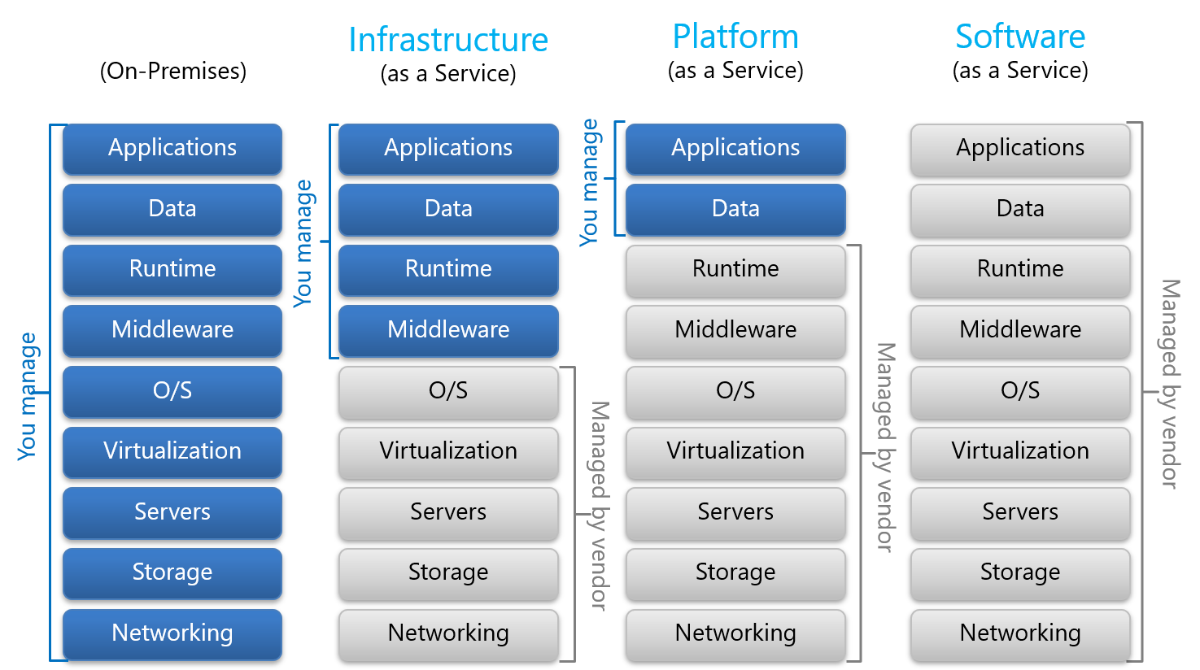
Cloud Models, Responsability Separation

Slide 8
Control vs Economy
Application runs
ON-PREMISES
Buy my own hardware, and manage my own data center
Application runs at a
HOSTER
Co location, or managed servers
Application runs using
CLOUD SERVICES
Cloud fabric
Elastic, infini-scale
Control
High
Low
Economy of Scale
Low
High

Slide 9
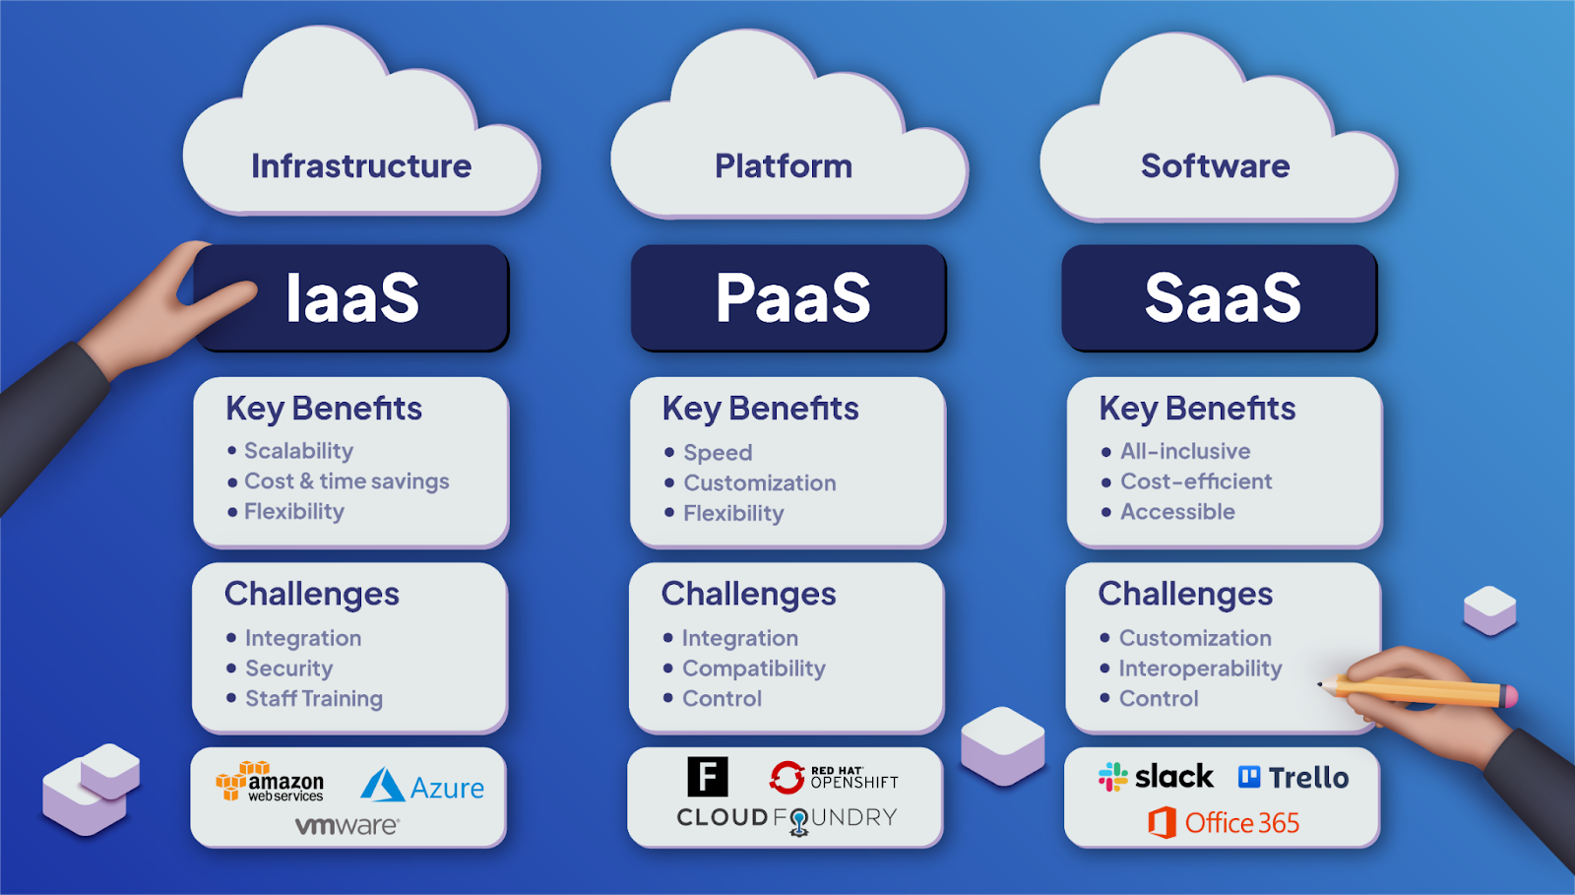
Cloud Models
A rapid sample

Slide 10
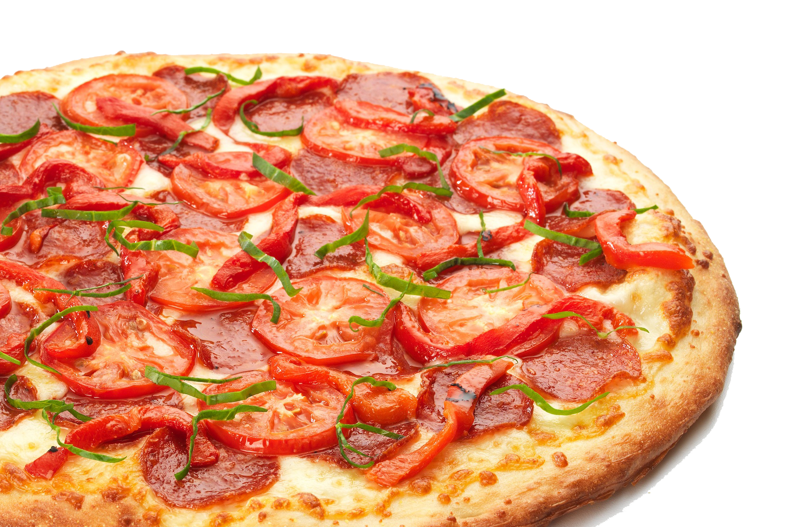
Pizza as a Service
A Great Analogy

Slide 11
Pizza as a Service (Great Analogy)
Traditional IT
(OnPremise)
Infraestructure as a Service (IaaS)
Platform as a Service
(PaaS)
Software as a Service
(SaaS)
Dinning Table
Dinning Table
Dinning Table
Dinning Table
Soda
Soda
Soda
Soda
Electric / Gas
Electric / Gas
Electric / Gas
Electric / Gas
Oven
Oven
Oven
Oven
Fire
Fire
Fire
Fire
Pizza Dough
Pizza Dough
Pizza Dough
Pizza Dough
Tomato Sauce
Tomato Sauce
Tomato Sauce
Tomato Sauce
Toppings
Toppings
Toppings
Toppings
Cheese
Cheese
Cheese
Cheese
Made at home
Take & Bake
Pizza Delivered
Dined Out

Slide 12

Any Questions?
Cloud Models

